Slide 1
Cloud: MAANG Stock Price Analysis
By Indra Kumar Chandaka ichandak@gitam.in

Slide 2
Problem Definition and Objective
In a rapidly evolving financial market, staying ahead of the trend analysis is essential for making informed investment decisions.
We also aim to explore the external factors that impact the stock price and the level of risk associated with their securities.
This project seeks to develop a data-driven solution to address the complexities of analyzing the historical stock prices of MAANG companies and identify the market conditions and external factors that could help make informed investment decisions.

Slide 3
End-Goal
The ultimate end goal of this project is to ensure we get valuable insights to empower and help investors, analysts and traders make informed decisions
The project aims to predict the effectiveness of trading strategies by back tracing with historical data insights and provide actionable insights to make data-driven decisions about the trends, opportunities, and volatility
Furthermore, by developing an efficient cloud-based data engineering solution that can handle large volumes of data for real-time analysis.

Slide 4
Data Source
This dataset includes the historical data of stock prices for MAANG companies. It contains the daily, weekly, and monthly stock prices for each company, and they are automatically updated daily
This dataset has 15 datasets, and each file has around 7 columns. Here we have daily, monthly, and weekly data for each of the companies from the years 2000 -2023.
http://www.kaggle.com/datasets/nikhil1e9/ne8lix-stock-price/

Slide 5
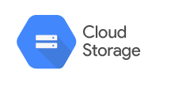








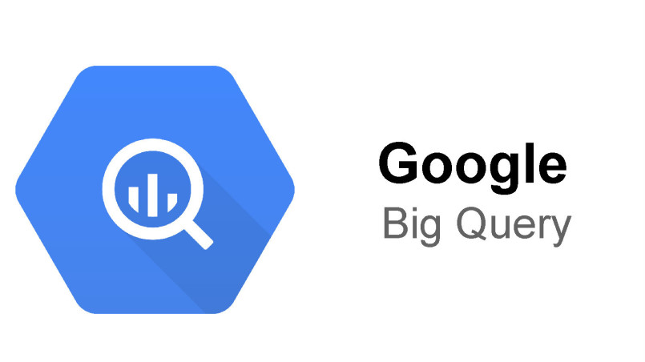


Data Pipeline Architecture
Data Source
Data Visualization
Extract CSV files
Temporary download files into GCS for processing
MAANG Datasets
Google Cloud Schedular
Transform
Load
Datastream for CDC captures

Slide 6
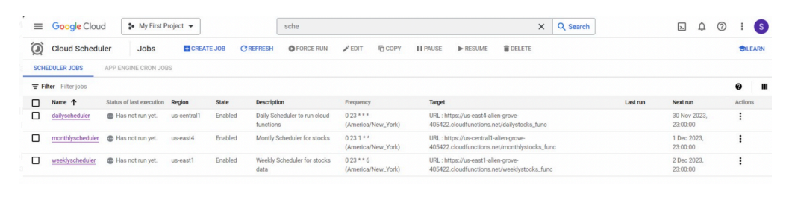
Data Ingestion – Cloud Schedular
We have adopted py scripts for daily, weekly, and monthly to transform and insert the 15 files into cloud Postgres. Here, we used the Kaggle API instead of downloading the 15 files into the local or cloud bucket, as the data is very dynamic and changes daily.
We are using a cloud scheduler to trigger the cloud functions.

Slide 7
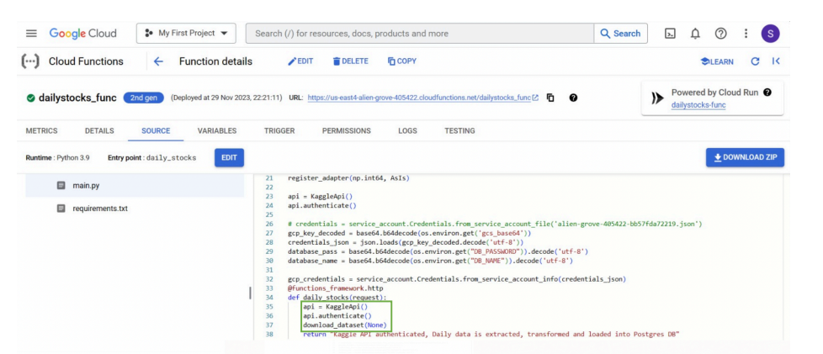
Cloud Functions

Slide 8
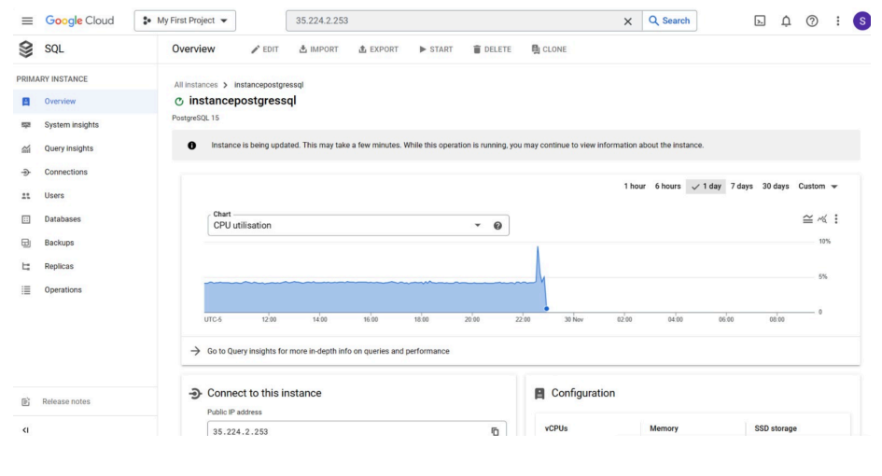
Cloud SQL Postgres

Slide 9
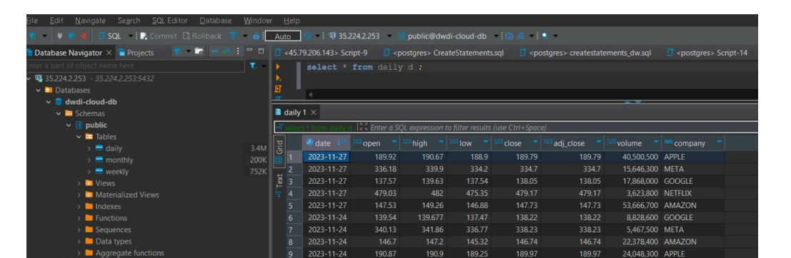
Database Connection

Slide 10
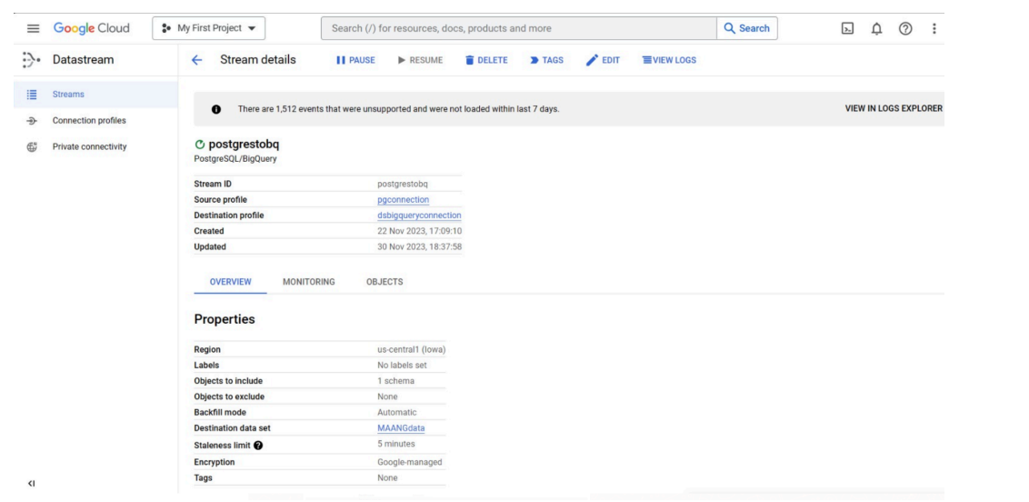
Data Ingestion From Cloud SQL to Bigquery using DataStream

Slide 11
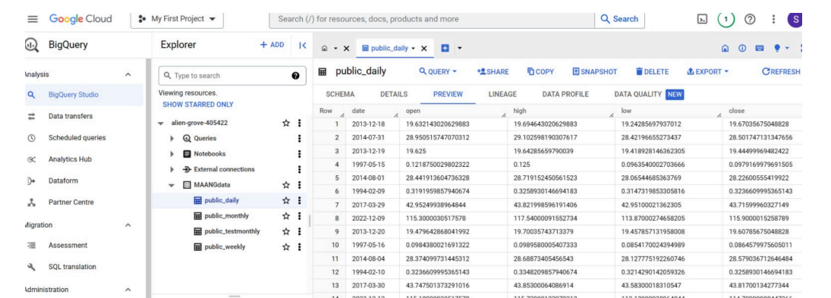
Bigquery Data Warehouse

Slide 12
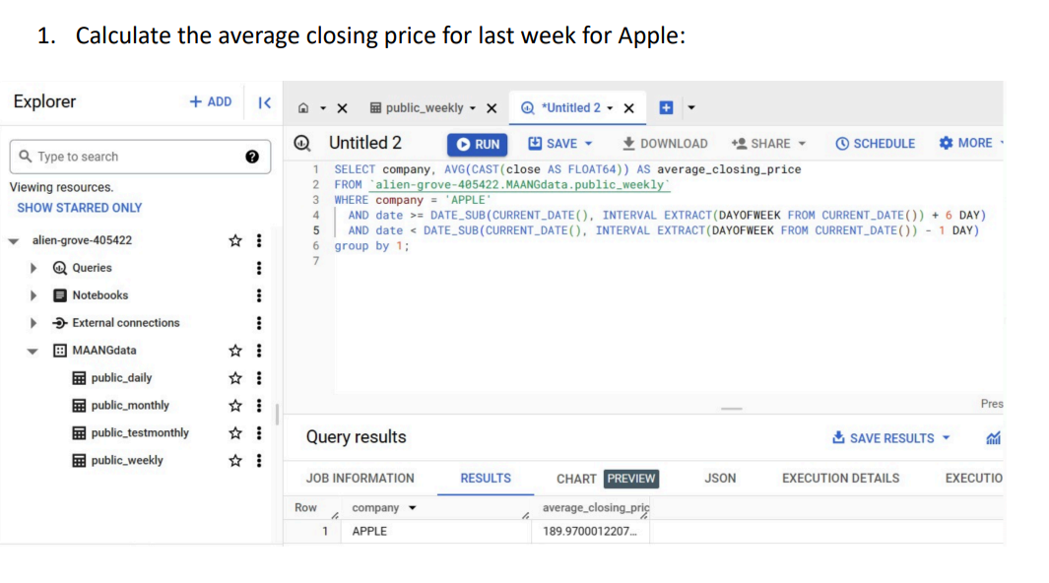
Analytical Queries

Slide 13
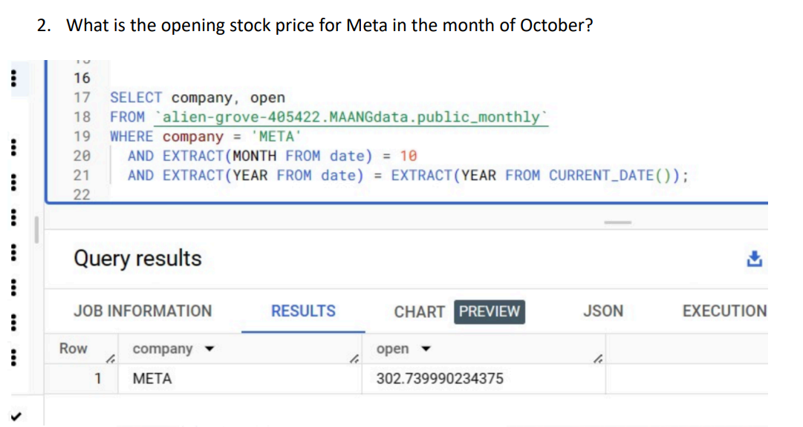
Cont.

Slide 14
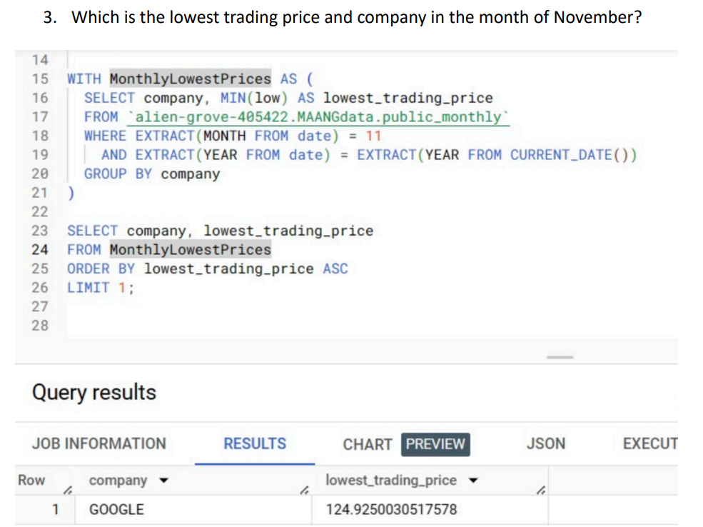
Cont.

Slide 15
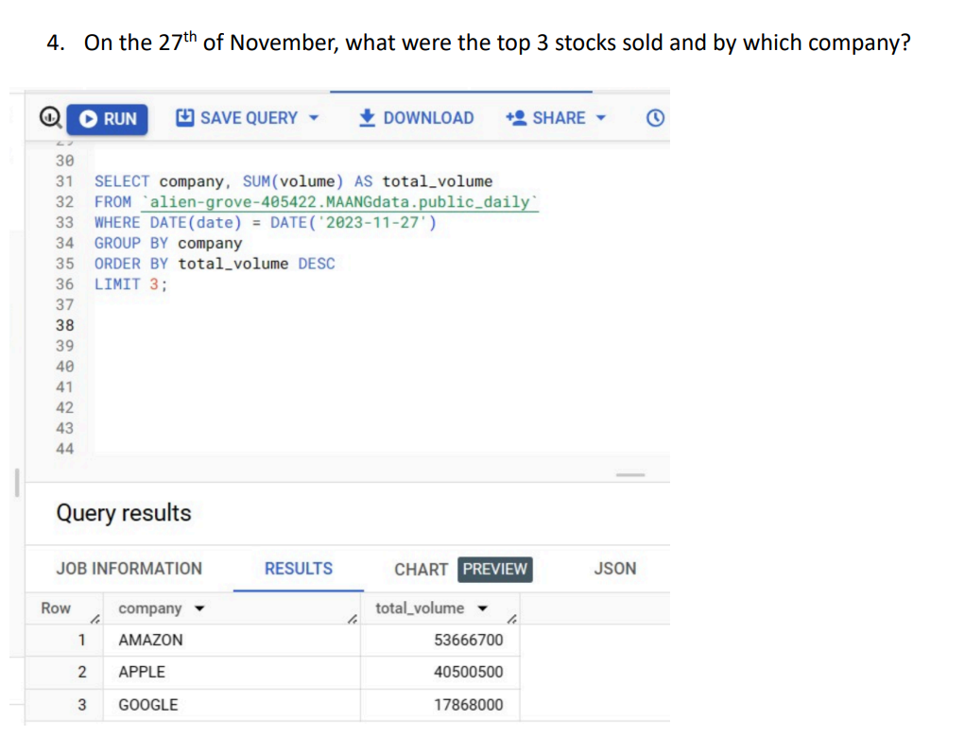
Cont.

Slide 16
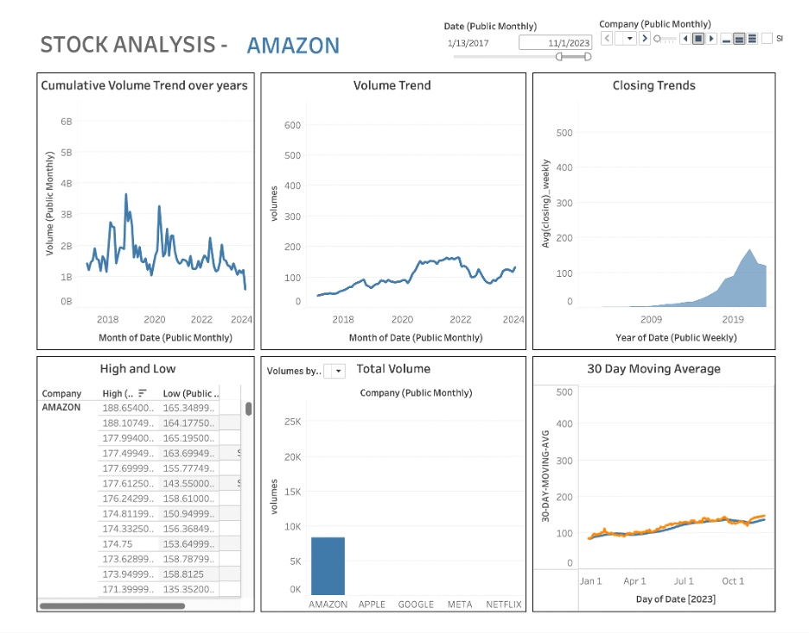
Tableau Dashboard

